Slide 1

Chapter 5: Project Scope Management
Information Technology Project Management, Seventh Edition
Note: See the text itself for full citations.

Slide 2
Learning Objectives
Understand the importance of good project scope management
Describe the process of planning scope management
List scope management processes and describe the contents of a project scope statement
Discuss methods for collecting and documenting requirements to meet stakeholder needs and expectations
Discuss the process for creating a work breakdown structure using the analogy, top-down, bottom-up, and mind-mapping approaches

Slide 3
Learning Objectives
Explain the importance of validating scope and how it relates to defining and controlling scope

Slide 4
What is Project Scope Management?
Scope refers to all the work involved in creating the products of the project and the processes used to create them
A deliverable is a product produced as part of a project, such as hardware or software, planning documents (e.g. project scope statement document), or meeting minutes
Project scope management includes the processes involved in defining and controlling what is or is not included in a project

Slide 5
Project Scope Management Processes
Planning scope: determining how the project’s scope and requirements will be managed [an overall plan- must have well established [repeatable] process- improve based on reflection from project to project; plan must cover the following]
Collecting requirements: defining and documenting the features and functions of the product which will be produced during the project as well as the processes used for creating them. [Plan- well established and repeatable process to capture functional and non-functional requirements]==> requirements of the system [accurate and reliable]
Defining scope: reviewing the project charter, requirements documents, and organizational process assets to create a project scope statement document
Defines the total work in the project
Agreement on the project work (deliverables) between project team and client
Not rigid – can change
Creating the WBS: subdividing the major project deliverables into smaller, more manageable components [based on development approach or development method]
Validating scope: formalizing acceptance of the project deliverables [stakeholder certifying and signing off before & after implementation]
Controlling scope: controlling changes to project scope throughout the life of the project [well established monitoring (implementation) and change management request processes]

Slide 6
Scope Management Plan Contents (Processes)
How to capture the requirements?
How to prepare a detailed project scope statement
Templates and guidelines to follow?
How much detail to provide for each deliverable?
How to create a WBS
Using guidelines
Analogy approach
Top-down approach
Bottom up approach
Mind-mapping approach
How to maintain and approve the WBS
Guidelines for maintaining and getting approval for WBS
How to obtain formal acceptance of the completed project deliverables
How to control requests for changes to the project scope

Slide 7
Requirements Management Plan
The PMBOK® Guide, Fifth Edition, describes requirements as “conditions or capabilities that must be met by the project or present in the product, service, or result to satisfy an agreement or other formally imposed specification”
The requirements management plan documents how project requirements will be analyzed, documented, and managed. It includes
How to plan, track, and report requirements activities
How to perform configuration management activities
How to prioritize requirements
How to trace and capture attributes of requirements

Slide 8
Collecting Requirements
For some IT projects, it is helpful to divide requirements development into categories called elicitation, analysis, specification, and validation
It is important to use an iterative approach to defining requirements since they are often unclear early in a project

Slide 9
Methods for Collecting Requirements
Interviewing
Focus groups and facilitated workshops
Using group creativity and decision-making techniques
Questionnaires and surveys
Observation
Prototyping
Benchmarking, or generating ideas by comparing specific project practices or product characteristics to those of other projects or products inside or outside the performing organization, can also be used to collect requirements

Slide 10
Examples of requirements
Functional requirements- features of a system (example taken from the web)
R1. The Background Task Manager shall display status messages in a designated area of the user interface at intervals of 60 plus or minus 10 seconds.
R2. If background task processing is progressing normally, the percentage of the background task processing that has been completed shall be displayed.
R3. A message shall be displayed when the background task is completed.
R4. An error message shall be displayed if the background task has stalled.
Shall, Will, and Should is the standard requirements terminology
*John Simpson, “2011: The State of Requirements Management” (2011).

Slide 11
Functional & non-functional requirements
Non-functional requirements:
are the attributes such as performance, security, usability, compatibility.
Not the "feature" of the system, but are a required characteristic
Example
The System shall have an availability of 999/1000 or 99%.
reliability requirement (out of every 1000 requests, 999 must be satisfied).
System shall process a minimum of 8 transactions per second.
performance requirement
The access permissions for system data may only be changed by the system’s data administrator
All system data must be backed up every 24 hours and the backup copies stored in a secure location which is not in the same building as the system
All external communications between the system’s data server and clients must be encrypted
3, 4 & 5 security requirement

Slide 12
Functional & non-functional requirements
R6. Novice users shall perform task X in Y minutes.
R7. The system shall use the screen pictures shown in App. xx.
R8. The menu points and push buttons shall function as shown in App. yy.
R9. The system shall follow the MS-Windows style guide.
R10. For input fields with a limited set of values, it must be possible for the user to select the value from a list.
R11. The interface must resemble the interface of application xx.
6-11 usability requirements

Slide 13
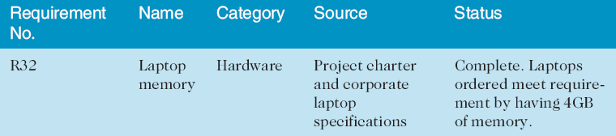
Requirements Traceability Matrix
A requirements traceability matrix (RTM) is a table that lists requirements, various attributes of each requirement, and the status of the requirements to ensure that all requirements are addressed
Table 5-1. Sample entry in an RTM

Slide 14
Defining Scope
Providing a detailed definition of the work for the projects
Good scope definition is needed for project success
improves accuracy of time, cost and resource estimates
defines a baseline for performance management and project control
aids for clearly communicating work responsibilities
Key input for preparing project scope statement
Project charter
Scope management plan
Requirements documents
Lesson learned report
Polices and procedures related to scope statements

Slide 15
Defining the project Scope (refer to the template) statement document
Contents vary but project scope statements should include:
at least a product scope description,
product user acceptance criteria (functional and non-functional requirements) and
all product & project deliverables
It is also helpful to document other scope-related information, such as the project boundaries, constraints, and assumptions.
The project scope statement must reference supporting documents, such as product specifications
As time progresses, the scope of a project should become more clear and specific
Refer to the template for the scope statement document

Slide 16
Creating the Work Breakdown Structure (WBS)
A WBS is a deliverable-oriented grouping of the work involved in a project that defines the total scope of the project
WBS is a foundation document that provides the basis for planning and managing project schedules, costs, resources, and changes
Decomposition is subdividing project deliverables into smaller pieces
A work package is a task at the lowest level of the WBS
The scope baseline includes the approved project scope statement and its associated WBS and WBS dictionary

Slide 17
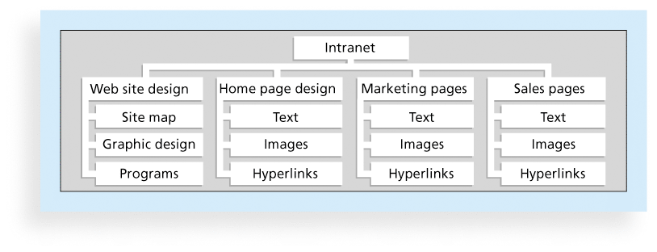
Figure 5-3. Sample Intranet WBS Organized by Product

Slide 18
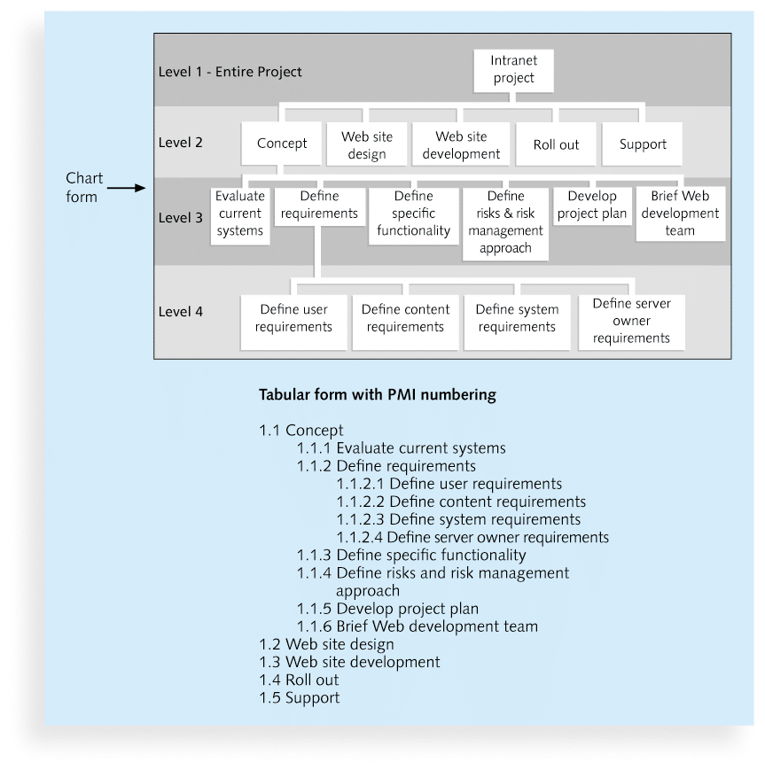
Figure 5-4. Sample Intranet WBS Organized by Phase

Slide 19
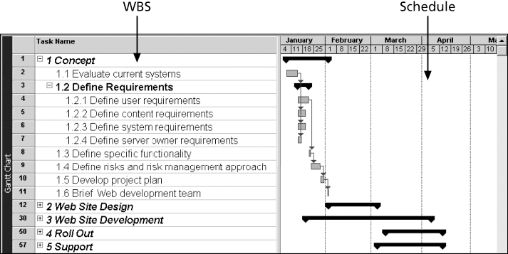
Figure 5-5. Intranet WBS and Gantt Chart in Microsoft Project

Slide 20
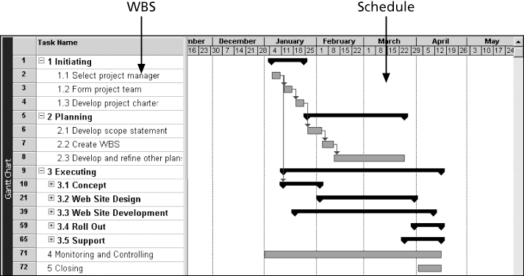
Figure 5-6. Intranet Gantt Chart Organized by Project Management Process Groups

Slide 21
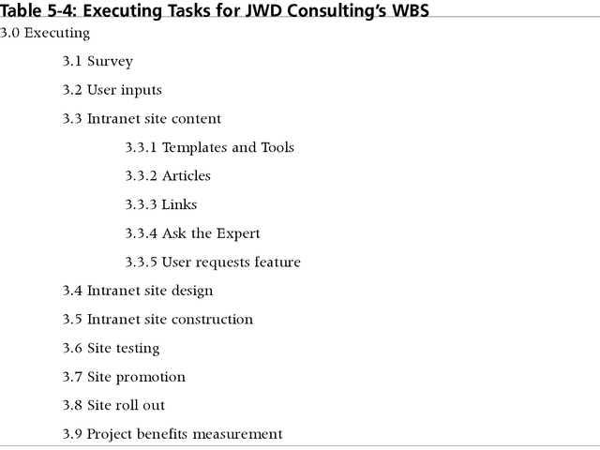
Table 5-4: Executing Tasks for JWD Consulting’s WBS

Slide 22
Approaches to Developing WBSs
Using guidelines: Some organizations provide guidelines/templates for preparing WBSs
The analogy approach: Review WBSs of similar projects and tailor to your project
The top-down approach: Start with the largest items of the project and break them down
The bottom-up approach: Start with the specific tasks and roll them up
Mind-mapping approach: Mind mapping is a technique that uses branches radiating out from a core idea to structure thoughts and ideas

Slide 23
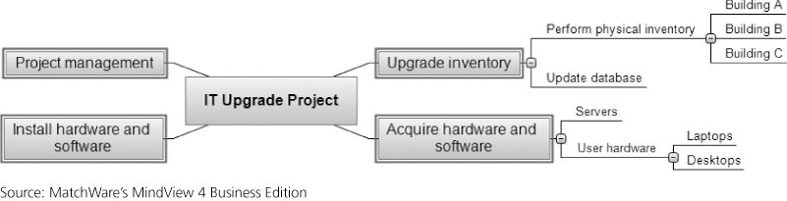
Figure 5-7. Sample Mind-Mapping Approach for Creating a WBS

Slide 24
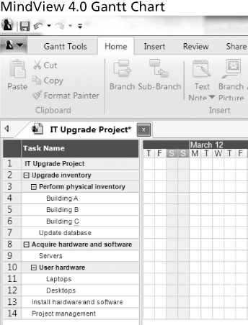
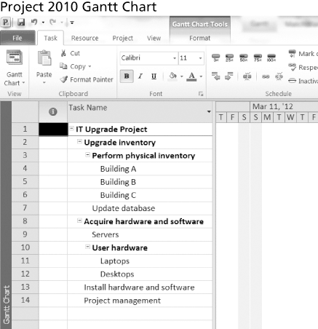
Figure 5-8. Gantt Charts With WBS Generated From a Mind Map

Slide 25
The WBS Dictionary and Scope Baseline
Many WBS tasks are vague and must be explained more so people know what to do and can estimate how long it will take and what it will cost to do the work
A WBS dictionary is a document that describes detailed information about each WBS item

Slide 26
Advice for Creating a WBS
A unit of work should appear at only one place in the WBS.
The work content of a WBS item is the sum of the WBS items below it
A WBS item is the responsibility of only one individual, even though many people may be working on it
The WBS must be consistent with the way in which work is actually going to be performed; it should serve the project team first, and other purposes only if practical

Slide 27
Advice for Creating a WBS
Project team members should be involved in developing the WBS to ensure consistency and buy-in
Each WBS item must be documented in a WBS dictionary to ensure accurate understanding of the scope of work included and not included in that item
The WBS must be a flexible tool to accommodate inevitable changes while properly maintaining control of the work content in the project according to the scope statement

Slide 28
Validating Scope
It is very difficult to create a good scope statement and WBS for a project
It is even more difficult to verify project scope and minimize scope changes
Scope validation involves formal acceptance of the completed project deliverables
Acceptance is often achieved by a customer inspection and then sign-off on key deliverables

Slide 29
Controlling Scope
Scope control involves controlling changes to the project scope
Goals of scope control are to
influence the factors that cause scope changes
assure changes are processed according to procedures developed as part of integrated change control, and
manage changes when they occur
Variance is the difference between planned and actual performance

Slide 30
Best Practices for Avoiding Scope Problems
1. Keep the scope realistic. Don’t make projects so large that they can’t be completed. Break large projects down into a series of smaller ones
2. Involve users in project scope management. Assign key users to the project team and give them ownership of requirements definition and scope verification
3. Use off-the-shelf hardware and software whenever possible. Many IT people enjoy using the latest and greatest technology, but business needs, not technology trends, must take priority
4. Follow good project management processes. As described in this chapter and others, there are well-defined processes for managing project scope and others aspects of projects

Slide 31
Suggestions for Improving User Input
Develop a good project selection process and insist that sponsors are from the user organization
Have users on the project team in important roles
Have regular meetings with defined agendas, and have users sign off on key deliverables presented at meetings
Deliver something to users and sponsors on a regular basis
Don’t promise to deliver when you know you can’t
Co-locate users with developers

Slide 32
Suggestions for Reducing Incomplete and Changing Requirements
Develop and follow a requirements management process
Use techniques such as prototyping, use case modeling, and JAD to get more user involvement
Put requirements in writing and keep them current
Create a requirements management database for documenting and controlling requirements

Slide 33
Suggestions for Reducing Incomplete and Changing Requirements (cont’d)
Provide adequate testing and conduct testing throughout the project life cycle
Review changes from a systems perspective
Emphasize completion dates to help focus on what’s most important
Allocate resources specifically for handling change requests/enhancements

Slide 34
Using Software to Assist in Project Scope Management
Word-processing software helps create several scope-related documents
Spreadsheets help to perform financial calculations, weighed scoring models, and develop charts and graphs
Communication software like e-mail and the Web help clarify and communicate scope information
Project management software helps in creating a WBS, the basis for tasks on a Gantt chart
Specialized software is available to assist in project scope management

Slide 35
Chapter Summary
Project scope management includes the processes required to ensure that the project addresses all the work required, and only the work required, to complete the project successfully
Main processes include
Define scope management
Collect requirements
Define scope
Create WBS
Validate scope
Control scope

